Slide 1

Sentiment Analysis for Product Insights
This project aims to develop a Natural Language Processing (NLP) model to analyze sentiment in Tweets related to Apple and Google products. By classifying the sentiment of these Tweets as positive, negative, or neutral, the model will provide valuable insights into public perception, aiding businesses in marketing strategies and product development.
By Group 4

Slide 2

Business Problem
1
Tracking Customer Sentiment
In an era dominated by social media, brands must continuously track customer sentiments expressed online. Twitter has become a critical platform where users voice their opinions about products and brands.
2
Manual Analysis Challenges
The vast volume and rapid pace of tweets make it impractical for businesses to manually analyze these opinions for insights. An NLP model is needed to automatically classify the sentiment of tweets and determine which brand or product is the target.

Slide 3
Objectives
1
To develop a binary classification model that classifies tweets as either positive or negative.
2
Expand the binary classifier to include neutral sentiments, creating a multiclass classifier using various models
3
The goal is to build an NLP model that can accurately and efficiently classify sentiments, identify brands/products, and handle ambiguity in tweets.

Slide 4
Dataset Overview
Dataset Size
The dataset from CrowdFlower includes over 9,000 tweets that have been evaluated for sentiment (positive, negative, or no emotion) and tagged with the associated brand or product.
Sentiment Distribution
The dataset shows a class imbalance, with more positive and neutral tweets compared to negative ones. This is a common challenge in sentiment analysis tasks.
Modeling Approach
The project initially focused on binary classification (positive vs. negative) and later expanded to a multi-class classification (positive, negative, neutral) to better understand the nuances of sentiment.

Slide 5
Modeling Techniques
1
Binary Classification
The team evaluated several models for binary classification, including Logistic Regression, Random Forest, SVM, Gradient Boosting, Neural Networks, and XGBoost.
2
Multi-class Classification
For the multi-class classification task, the same set of models were tested to identify positive, negative, and neutral sentiments.
3
Class Imbalance Handling
To address the class imbalance, the team used techniques like class weighting and SMOTE (Synthetic Minority Over-sampling Technique) to improve model performance, especially for the minority class (negative sentiment).

Slide 6
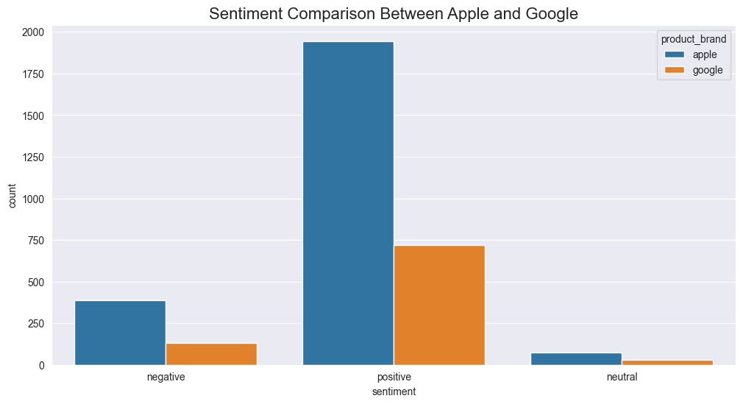
Visualizations Sentiment Comparison Between Apple and Google Products
The bar chart compares the sentiment distribution between Apple and Google products. For positive sentiment, Apple has a significantly higher count compared to Google, indicating a strong positive reaction toward Apple products. Negative sentiment is more balanced but still higher for Apple than Google. Both brands have very low counts in the neutral sentiment category, with Apple showing slightly more mentions than Google. This comparison suggests that Apple products generate more engagement, particularly in positive sentiment, than Google products.

Slide 7
Model Evaluation
1. Binary Classification
In binary classification, SVM with class weighting performed the best, achieving an accuracy of 0.9054 and an F1 score of 0.8973
2. Multi-class Classification
For multi-class classification, SVM with class weighting again showed the best results, with an accuracy of 0.8970 and an F1 score of 0.8903.
3. Class Imbalance Impact
Handling class imbalances significantly improved model performance, especially for the minority class (negative emotions).
4. Comparison of Techniques
Class weighting slightly outperformed SMOTE in most cases, making it the preferred technique for handling class imbalances

Slide 8

Recommendations
Primary Model Selection
SVM with class weighting is the preferred model for both binary and multi-class sentiment analysis tasks based on the evaluation results.
Class Imbalance Handling
Use class weighting as the primary technique for addressing class imbalances, as it slightly outperformed SMOTE in most cases.
Further Data Collection
Collect a larger and more balanced dataset to improve the model's performance and generalization, as the current dataset has limitations in size and class imbalance.

Slide 9



Conclusion
Best Model
SVM with class weighting provided the highest accuracy and F1 scores for both binary and multi- class classifications, making it the best model for this sentiment analysis task.
Class Imbalance Impact
Handling class imbalances significantly improved model performance, particularly for the minority class (negative sentiment), highlighting the importance of addressing this challenge.
Textual Variations and Context
The model faces challenges in handling the informal language and sentiment subtleties commonly seen in social media posts, emphasizing the need for more context-aware models.

Slide 10
Future Improvements
Expand Data Sources
Incorporate more diverse data sources beyond Twitter, such as reviews, forums, and other social media platforms, to enhance the model's ability to handle a wider range of textual variations and contexts.
Contextual Understanding
Explore advanced NLP techniques, like transformer-based models (e.g., BERT, RoBERTa), to better capture the nuances of sentiment and improve the model's understanding of the underlying context.
Real-Time Processing
Develop a scalable solution that can process large volumes of data in real-time, enabling businesses to respond promptly to customer feedback and optimize their marketing strategies based on up- to-date sentiment analysis.

Slide 11

Ethical Considerations
1
Privacy and Data Protection
Ensure that the sentiment analysis model and its deployment adhere to strict data privacy and protection guidelines, respecting the privacy of individuals whose tweets are analyzed.
2
Bias Mitigation
Continuously monitor the model for potential biases, and implement strategies to identify and mitigate any biases that may arise from the dataset or the model's architecture.
3
Responsible AI Practices
Adopt responsible AI principles, such as transparency, accountability, and fairness, to build trust and ensure the ethical use of the sentiment analysis model in business decision-making.

Slide 12
Acknowledgments
CrowdFlower Dataset
The project team would like to acknowledge the CrowdFlower team for providing the valuable dataset used in this sentiment analysis study.
Research Collaborators
The team would also like to thank the research collaborators and subject matter experts who provided valuable insights and guidance throughout the project.
Continuous Learning
The team is committed to ongoing learning and improvement, and welcomes feedback and suggestions from the broader community to enhance the sentiment analysis model and its applications.

Slide 13
Thank You!

